Slide 1
HEALTHCARE ANALYSIS
Group 2

Slide 2
TEAM MEMBERS
Akshata Pawar
Nilesh Rathod
Aditya Yadav
Sanaa Shaikh
Shreyas Padmawar
Shreya Mehta
Jahnavi Reddy

Slide 3
INTRODUCTION OF HEALTHCARE
Healthcare is a broad and multifaceted field dedicated to the maintenance and improvement of health, the prevention and treatment of illness and injury, and the promotion of well-being for individuals and communities. Here are key aspects of healthcare:
Healthcare Providers
Healthcare Services
Healthcare Systems
Healthcare Financing
Healthcare Quality and Safety
Healthcare Technologies
Healthcare Policy and Regulation
Global Health Challenges

Slide 4
HEALTHCARE KPI’S
TOTAL DISCHARGES
PATIENT DAYS
NET PATIENT REVENUE
REVENUE TRANED
PATIENT STAYS
STATE WISE NUMBER OF HOSPITAL/ REVENUE
TYPE OF HOSPITAL REVENUE
MTD/QTD/YTD REVENUE
TOTAL PATIENT, TOTAL DOCTORS, TOTAL HOSPITAL

Slide 5
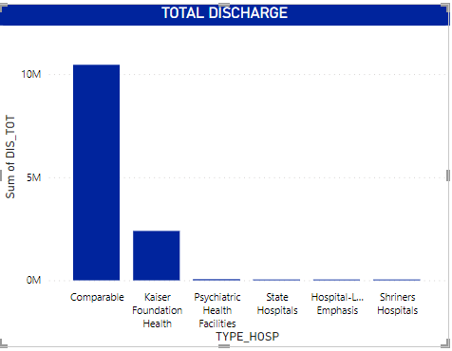
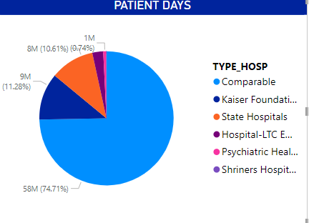
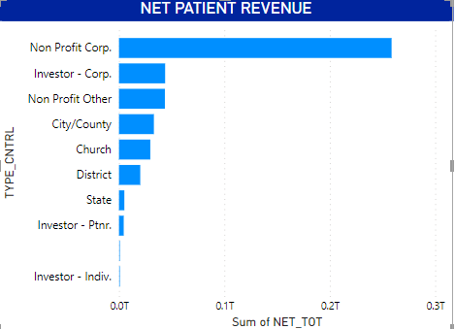
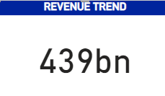
HEALTHCARE KPI’S INSIGHT
TOTAL DISCHARGES : By delving into these aspects of total discharge data, Hospital COMPARABLE can gain valuable insights to optimize operations, improve patient care, and enhance overall performance.
PATIENT DAYS : Most patients spend between 1 and 4 days in the hospital, with the majority staying for 3 days. Lab procedures have a positive relationship with length of stay, with more procedures leading to longer stays
NET PATIENT REVENUE : By leveraging insights from net patient revenue analysis, healthcare organizations can optimize revenue performance, mitigate financial risks, and enhance overall financial stability and sustainability.
REVENUE TRANED : Overall, analyzing revenue trends provides businesses with valuable insights into their financial performance, market dynamics, and growth opportunities. By leveraging these insights, businesses can make informed decisions, optimize strategies, and drive sustainable growth and profitability.

Slide 6
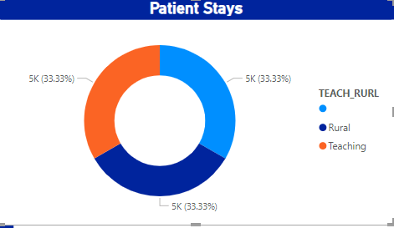
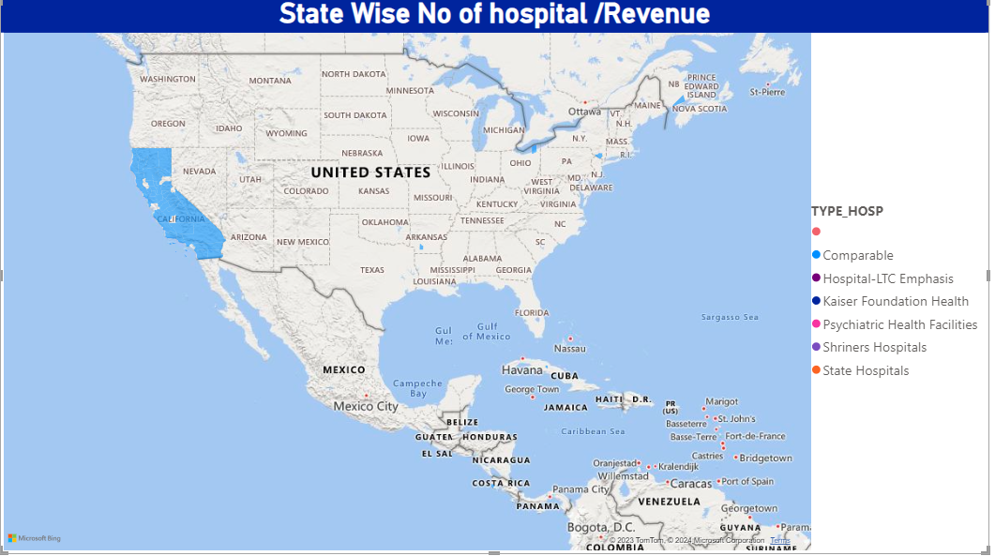
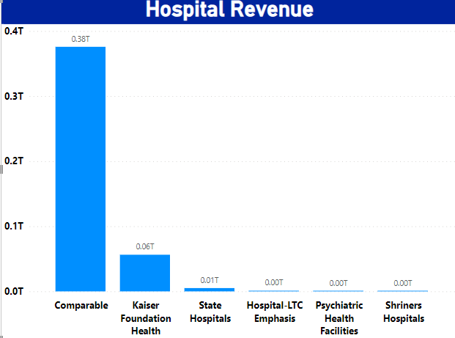
HEALTHCARE KPI’S INSIGHT
PATIENT STAYS : The average length of stay (ALOS) is a key metric for evaluating facility utilization, allowing administrators to optimize resource allocation, manage capacity, control costs, and improve patient satisfaction.
STATE WISE NUMBER OF HOSPITAL/ REVENUE : Positive doctor-hospital staff interaction in Alaska, Montana, South Dakota, and North Dakota, with no changes in Minnesota and Utah, while central and northern states excel, with Maine worst.
TYPE OF HOSPITAL REVENUE : By analyzing these different types of hospital revenue, healthcare organizations can gain insights into their financial performance, identify revenue optimization opportunities, and make informed decisions to achieve their strategic objectives while ensuring high-quality patient care and financial sustainability.

Slide 7
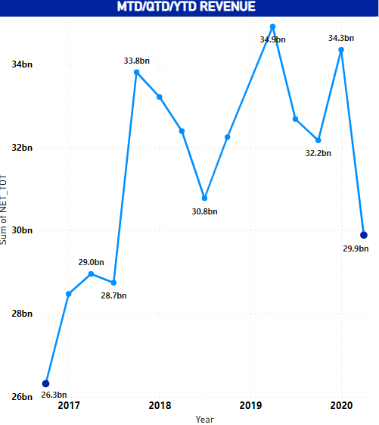
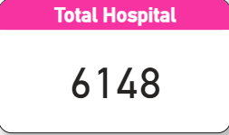
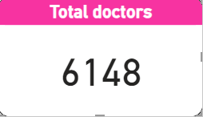
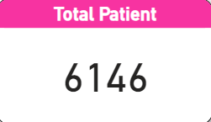
HEALTHCARE KPI’S INSIGHT
MTD/QTD/YTD REVENUE : By leveraging insights from MTD, QTD, and YTD revenue analysis, businesses can effectively monitor performance, identify revenue optimization opportunities, and make data-driven decisions to drive financial success and achieve their strategic objectives
TOTAL PATIENT, TOTAL DOCTORS, TOTAL HOSPITAL : The average length of stay (ALOS) is a crucial metric for evaluating facility utilization, allowing administrators to optimize resource allocation, manage capacity, control costs, and improve patient satisfaction.

Slide 8
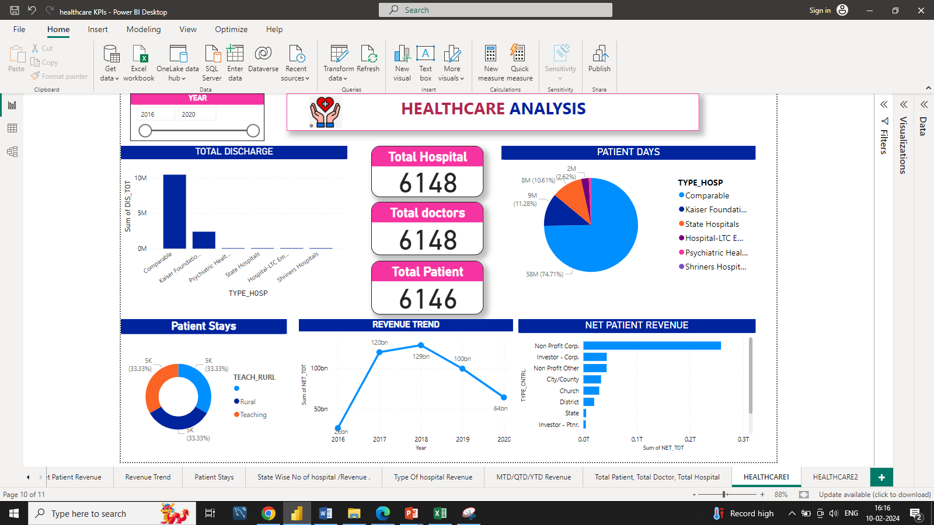
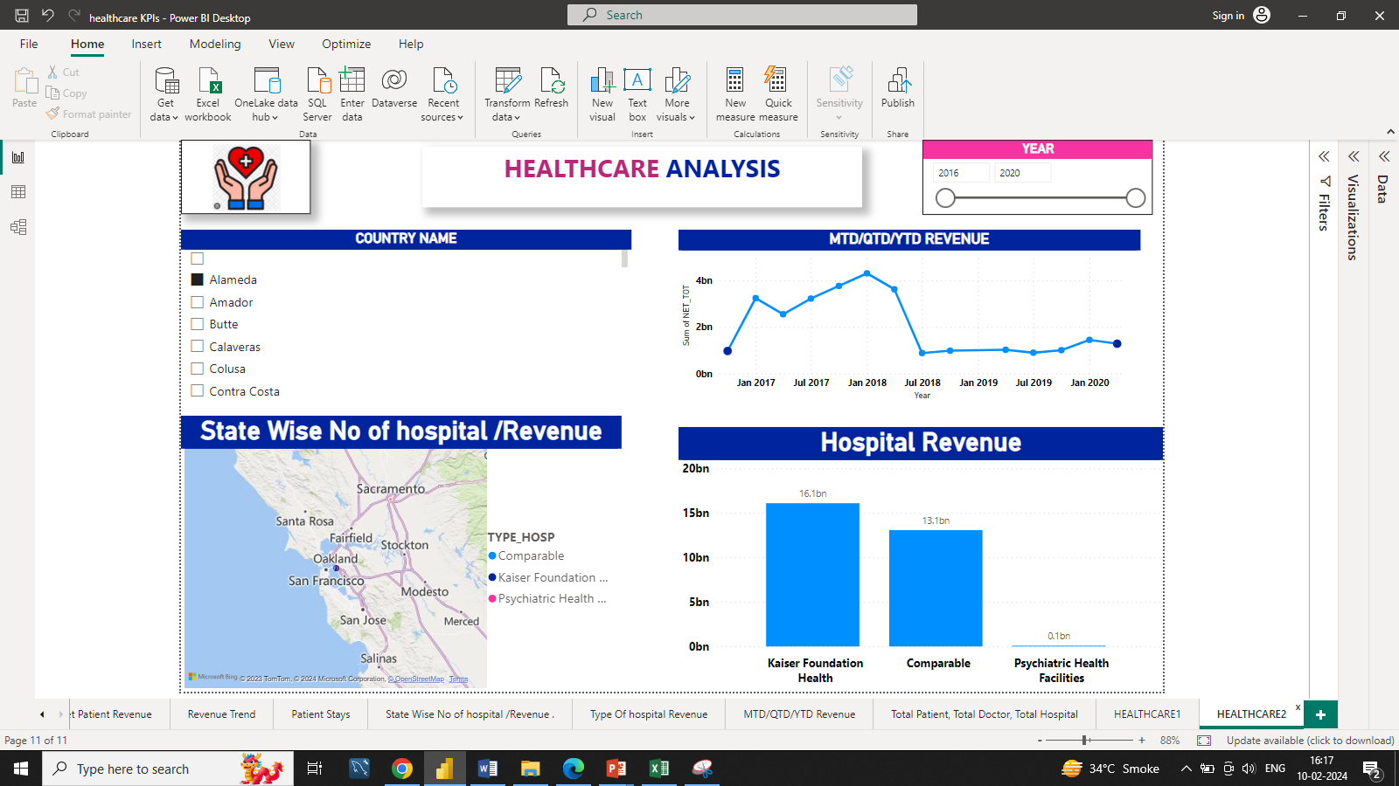
Power BI Dashboard

Slide 9
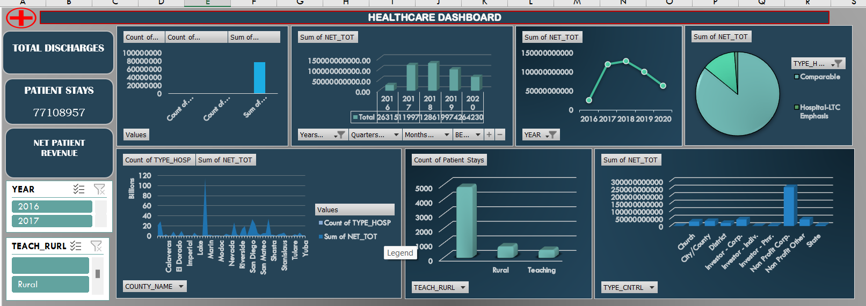
Excel Dashboard

Slide 10
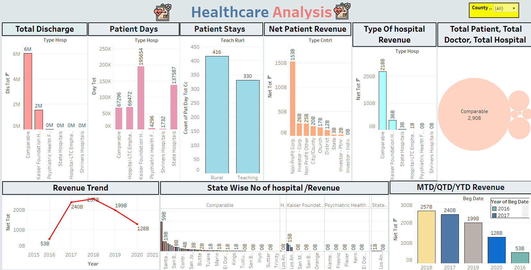
Tableau Dashboard

Slide 11
CONCLUSION:-
Based on the insights derived from analyzing month-to-date (MTD), quarter-to-date (QTD), and year-to-date (YTD) revenue trends, several key conclusions can be drawn: Performance Assessment, Timely Decision-Making, Seasonal Variations and Trends, Performance Comparison and Benchmarking, Forecasting and Planning.
Overall, leveraging insights from MTD, QTD, and YTD revenue analysis enables businesses to make informed decisions, optimize revenue performance, and achieve their strategic objectives in a dynamic and competitive market environment. By continuously monitoring revenue trends and adapting strategies accordingly, businesses can enhance financial stability, maintain resilience, and drive long-term success.

Slide 12
Thank You !!

